Slide 1

Heart Disease Prediction Using Data Mining Techniques
Group No: 3
MOHIT KHORA- B118035
SAANIDHYA VATS- B118050

Slide 2
Work Flow
Data Preprocessing
Data Visualization
Following algorithms have been used:
a)KNN, SVM, Naive Bayes (Algorithms used in paper)
b) Random Forest, Artificial Neural Network( Though not mentioned in paper but have produced good accuracy results in various other problem statements)

Slide 3
INTRODUCTION
Heart diseases have an abundant pact of attention in medical research due to its impact on human health. Data mining has developed as a vital approach for computing applications in medical informatics.
In this work, supervised machine learning algorithms namely SVM, KNN and Naive Bayes are used to predict the heart diseases.
The machine learning algorithms are being implemented using Python language.

Slide 4
Data Set
The data set used in this research work is from UCI Machine Learning Repository
The dataset is a collection of medical analytical reports with values for 76 attributes, but all published experiments refer to using a subset of 14 of them. Total four files are available in this repository but most of the research paper ( including this one) use Cleveland data for analysis and prediction purposes.

Slide 5
Attribute Information
Age: Age in years
Sex: Male (1), Female (0)
Testbps: Resting blood pressure (in mm Hg)
Cp: Chest pain type
Chol: Serum Cholestrol in mg/dl
Fbs: Fasting blood sugar > 120 mg/dl
Restecg: Resting Electrocardiography results
Thalach: Maximum heart rate achieved
Exang: Exercise induced angina
Old peak ST: Depression induced by exercise relative to rest
Slope: The slope of the peak exercise segment
Ca: Number of major vessels color by fluroscopy that ranges between 0 and 3
Thal: 3=Normal, 6=fixed defect, 7=reversibel defet

Slide 6
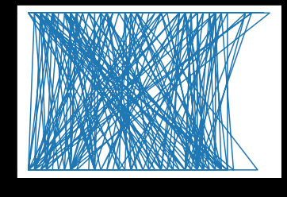
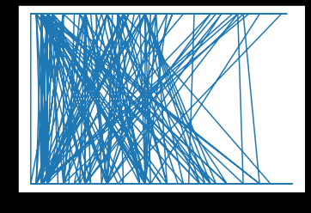
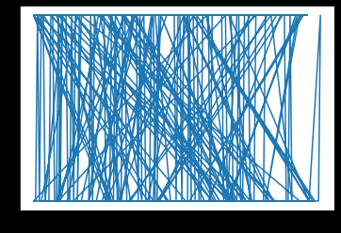
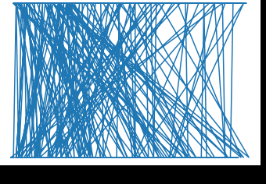
Target vs Age
Target vs Trestbps
Target vs Chol
Target vs Thalach

Slide 7
Train and Test set
The output data consists of 4 categories among which category 1,2 and 3 we're the variants of heart disease and 0 denoted no disease.
The paper focused on binary classification problem with 0 as no heart disease and 1 as heart disease. Hence the labels 1,2,3 we're converted to label 1.
Dataset was divided into train and test set in the ratio of 70:30.

Slide 8
Data Mining Techniques

Slide 9

K- Nearest Neighbour Algorithm (Pseudocode)
Calculate “d(x, xi)” i =1, 2, ….., n; where d denotes the Euclidean distance between the points is calculated as follows
distance=
Organise the premeditated n Euclidean distances in increasing order.
Let k be a +ve number, take the leading k distances from this sorted list.
Find those k-points corresponding to these k-distances.
Let ki denotes the quantity of facts fitting to the ith class among k points i.e. k ≥ 0 • If ki >kj ∀ i ≠ j then put x in class i.
In our project, the value of K was varied from 1-10.

Slide 10
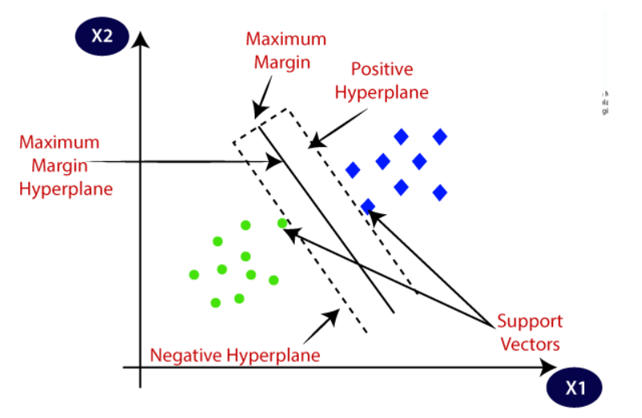
Support Vector Machine

Slide 11
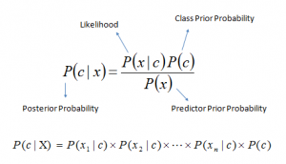
Naive Bayes Algorithm

Slide 12
Random Forest
The "forest" it builds, is an ensemble of decision trees, usually trained with the “bagging” method. The general idea of the bagging method is that a combination of learning models increases the overall result.
It basically random forest builds multiple decision trees and merges them together to get a more accurate and stable prediction.
At each split or node in this cluster/tree/dendrogram variables are chosen at random by the program to judge whether datapoints have a close relationship or not.
The program makes multiple trees a.k.a. a forest. Each tree is different because for each split in a tree, variables are chosen at random.

Slide 13
Artificial Neural Network
An artificial neural network is an interconnected group of nodes, inspired by a simplification of neurons in a brain.
It includes forward propagation for predicting the result of data.
The backward propagation is required to minimize the error between predicted value and actual value. In Backpropagation algorithm, the value of the weights get updated.
We have used a fully connected 3 layered fully connected neural network. The hidden layer consists of 11 nodes with relu activation function and the output layer consists of 1 node with sigmoid activation function.
Model was trained with 200 epochs with a batch size of 10.

Slide 14
Accuracy on Test set
KNN: 70.3 % (K=5 gave the best accuracy)
SVM: 84.62% (Linear Kernel)
Naive Bayes: 83.52%
Random Forest: 83.51%
Artificial Neural Network: 83.52%
SVM (poly kernel - non linear): 64.84%
SVM ( rbf kernel- non linear): 62.64%
In our project out of the three methods SVM with Linear Kernel has the best accuracy.
Confusion matrix: [[30, 11],
[ 3, 47]]

Slide 15
THANK YOU

